Slide 1
CODEDEALERS

Slide 2
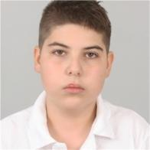
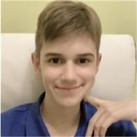
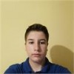

Our team.
DANAIL TODOROV
ZAFIR STOQNOV
DANIEL VASILEV
VENELIN NIKOLOV
SCRUM TRAINER
BACKEND DEVELOPER
BACKEND DEVELOPER
Q&A

Slide 3
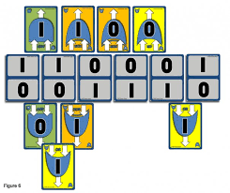


Our idea.
+
=

Slide 4


PROGRAMS, THAT WE HAVE USED.
PROGRAM LANGUAGE THAT WE USED.

Slide 5
Stages of work.

Slide 6
LET’S JUMP TO THE GAME!

